Slide 1
CasinoSim
Paige Johnson, Derek Gorthy, Michael Condon

Slide 2
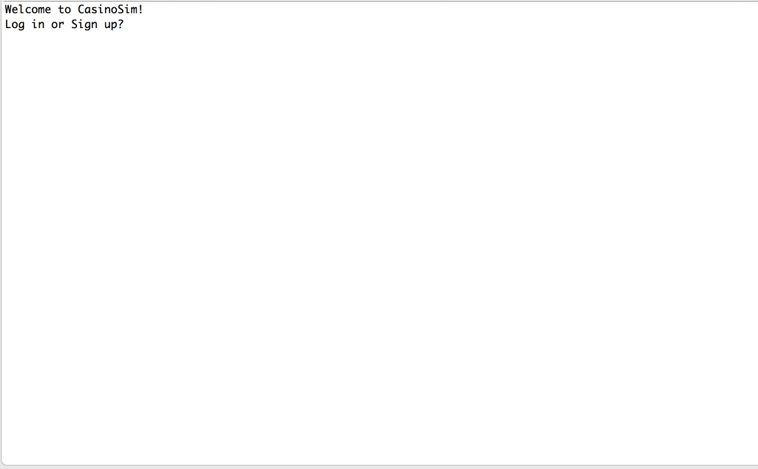
Demo

Slide 3
Game Implementation
Originally declared each on individually
Revised to utilize the decorator class to avoid bloated code
More generally, decorator is a useful pattern if aspects of a game can be generalized to individual components

Slide 4
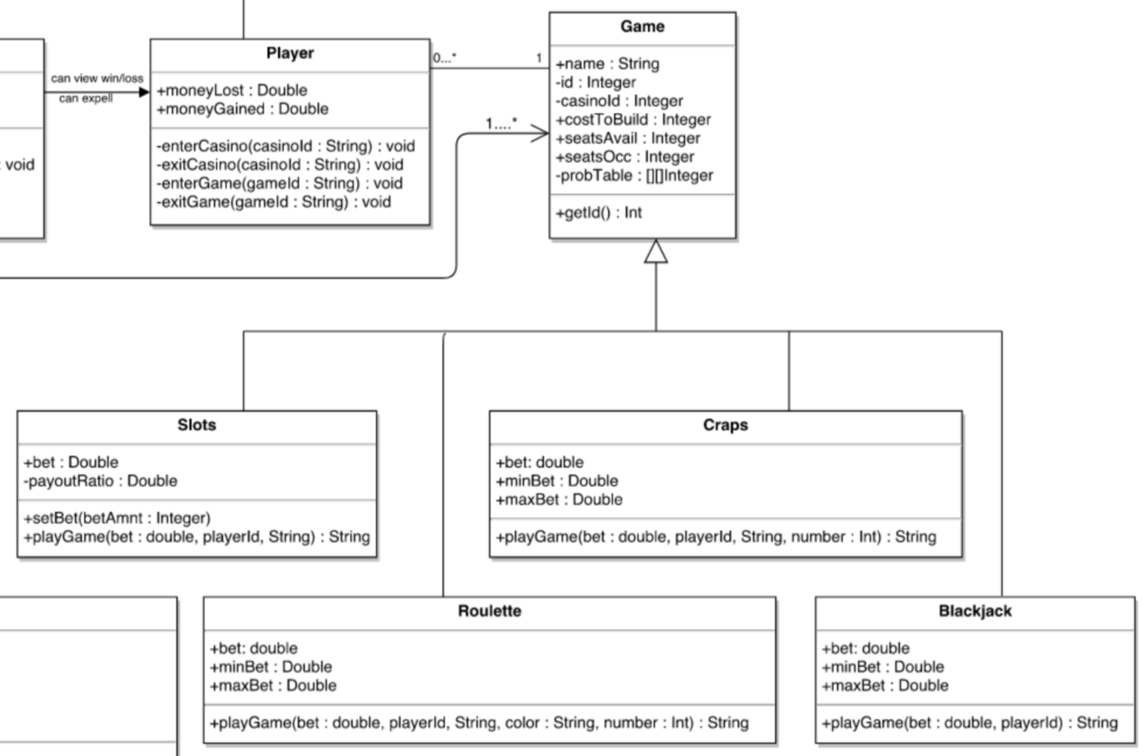

Slide 5
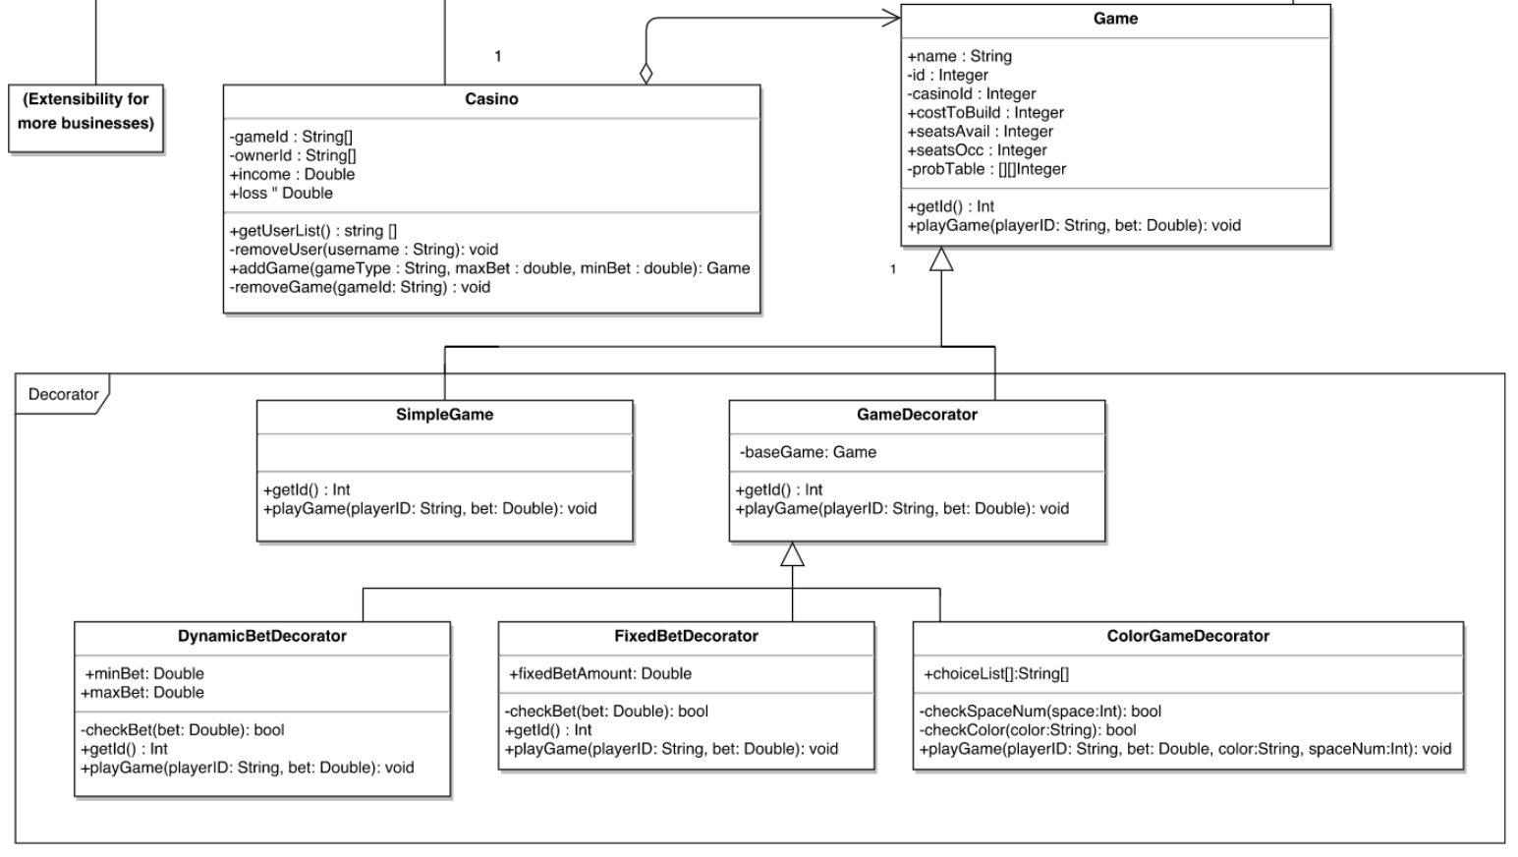
Demo Here

Slide 6
Further Extensibility
Designed system to accommodate other business types in the future
While we never proposed different types of businesses, we thought it was important to leave code open to expansion

Slide 7
